Slide 1
Travel Behavior Classification: An Approach with Social Network and Deep Learning
Name : Vishal Brahmbhatt
UCID : vdb2@njit.edu

Slide 2
Abstract
Not just for transport demand research, but also for ride-sharing opportunities, it's important to consider human travel behavior.
This paper introduces a deep-learning-driven approach to classifying travelers' habits based on trip features such as time of day and day of week for journeys, travel styles, prior trip reasons, personal demographics, and nearby location categories of trip ends to group similar travelers.
This study first examines the dataset of California Household Travel Survey (CHTS) between the years 2012 and 2013.
After preprocessing and exploring the raw data, an activity matrix for each participant is generated.
To measure matrix similarities between each pair of people, the Jaccard similarity coefficient is used.
Furthermore, based on matrix similarity metrics, a group social network is built for all members. A population recognition algorithm is then used to organize travelers who exhibit identical travel activity into the same categories.
There are five clusters detected: non-working people with more shopping activities, non-working people with more recreation activities, normal commute working people, shorter working duration people, later working time people, and individuals needing to attend school. An image of activity map is built from each participant’s activity matrix. Finally, a deep learning approach with convolutional neural network is employed to classify travelers into corresponding groups according to their activity maps. The accuracy of classification reaches up to 97%. The proposed approach offers a new perspective for travel behavior analysis and traveler classification.

Slide 3
Literature Review: a) Travel Behavior Data Analysis and Classification
The survey-based methods used for trip data collection went through the stages of paper and pencil interviews (PAPI), computer-assisted telephone interviews (CATI), and computer-assisted-self- interviews (CASI).
GPS and GIS technologies have been used to supplement the traditional survey data.
GPS and GIS land use data can be used for trip identification, travel characteristics identification, trip end clustering, and trip purpose prediction.
The data collected by this method in Singapore was further implemented with an ensemble-learning- based classification method to recognize travel patterns.
Researchers have also been making great efforts to classify travelers by using daily travel data and sociodemographic data.
Individuals were divided into five homogeneous travel behavior groups by using complex multi-day travel data and explained variability in individual’s daily travels.
The data was grouped into three temporal– spatial time geographies using a sequence alignment approach based on GPS data.
Travel behavior classification not only differentiates individuals with different travel patterns, but also uncovers human mobility patterns.
With the combination of several machine learning algorithms, Ma et al. identified travel patterns for transit riders from smart transit card data in order to attract more users, retain loyal users, and finally improve overall transit services performance.

Slide 4
b) Community Detection
A community is a collection of nodes that are homogeneous within the group and heterogeneous with other groups in the network, and this kind of network is known as a community structure.
They also developed a community detection algorithm and proposed a new community structure strength measurement.
Radicchi et al. developed a fully self-contained new local algorithm for community detection and tested it on both artificial and real-world network graphs.
The group detection algorithm has many benefits over conventional clustering algorithms.
To start with, it is simple to execute, and the steps are straightforward.
Second, for various stages, final networks may be decomposed into populations.
Third, even for large and high-dimensional datasets, this algorithm is fast.

Slide 5
c) Deep Learning
Deep learning or deep neural network, as a branch of machine learning and AI, is an artificial neural network that contains more than one hidden layer.
This kind of algorithm has shown superior performance especially in automatic speech recognition, image recognition, natural language processing, and recommendation systems.
Deep neural networks typically can be categorized into two types, recurrent neural networks and convolutional neural networks .
Long short-term memory RNNs is a widely used algorithm in the field of speech recognition .
However, in the field of image recognition, the CNN is the most prevailing algorithm.
Krizhevshy et al. developed a CNN consisting of five convolutional layers, some of these followed by max pooling layers and three fully-connected layers.
This network achieved an error rate of 15.3% while implementing the ImageNet Large Scale Visual Recognition Challenge -2012 dataset .
Simonyan and Zisserman improved CNNs with utilizing very small convolution filters and reached an error rate of 6.8% on the ILSVRC-2014 dataset.
This technique also has been applied in transportation, especially in the visual sensor data processing domain.
Dong et al. combined CNN and RNN to extract features to represent driver behaviors.
A driver classification task was also conducted, and they achieved significant outstanding performance compared with traditional machine learning algorithms .

Slide 6
Data Description and Preliminary Analysis
In this paper, the raw data is acquired from the California Household Travel Survey conducted by the California Department of Transportation from February 2012 to January 2013.
Households who conducted the survey with GPS devices generated both survey and GPS data. The survey data includes activities they completed on the assigned travel date only.
There are 39 different trip purposes included in this household travel survey.
These trip purposes are categorized into eight groups, which are home, work, school, transportation or transitions , shopping or errands , personal business , recreation or entertainment , and other as shown in Table 1.
Table 2 verifies the common knowledge that there are more work and school activities during weekdays, while people have more recreation, shopping, and personal business activities on weekends.
It is found that the aver- age time individuals spend at home is 13.98 hours per day during weekdays and 16.77 hours on weekends, respectively. This study only utilizes data of participants who have both valid survey and GPS data.
Several rules are created as follows in order to screen the feasible data.Both the first and last activity location should be ‘home’.
If individuals stay at home for a whole assigned travel day, travel information cannot be retrieved.
From the household survey data, it is noticed that there might be more than one driver utilizing the same vehicles within a household.
After these rules are applied, 8,849 unique individuals remain with 50,103 trips in this research.
On the contrary, individuals’ departure and return times are restricted by work or study on weekdays.

Slide 7
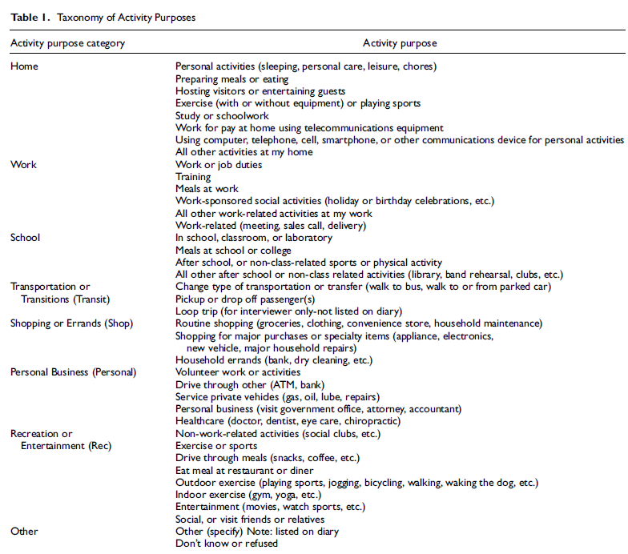
Table 1

Slide 8
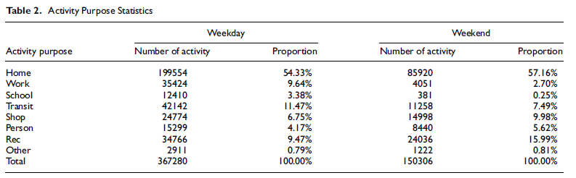
Table 2

Slide 9

Methodology: a) Matrix Similarities
In this paper, individuals’ daily activities are represented using a matrix. In order to construct this matrix, all activity purposes are categorized into eight groups and 24 hours are divided into 288 five-minute bins.
Therefore, the dimension of the matrix is 8 x 288. Each activity starts from the trip starting time for this activity and ends when the activity ends.
Individuals only can conduct one of eight activities shown in Table 3 at one time.
In this fashion, a binary matrix is generated to represent daily activities. The two plots in Figure 3 are examples of color-coded daily activity matrices for two individuals. Figure 3a is a daily activity map of a student.
Given an individual’s activity matrix, the similarity between every pair of participants is now calculated for constructing the community structure.
In this paper, the Jaccard similarity coefficient is implemented to measure similarities for binary matrices of individuals’ daily trips.

Slide 10
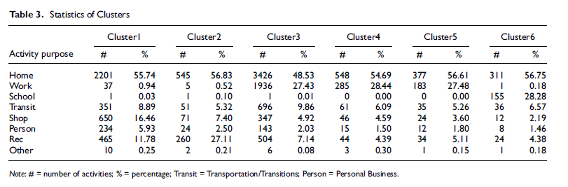
Table 3

Slide 11
b) Community Detection
After building the social network, the fast-unfolding community detection method is employed to cluster nodes . This is a kind of modularity maximization algorithm which is one of the most widely used methods for community detection.
In community detection, the modularity of a partition measures the density of edges within communities while comparing with edges between communities and scales between –1 and 1.
First, each node is assigned to different communities so that each node is a community, and the initial number of communities is as many as nodes.
Then, for each node i, the gains of modularity are measured when removing i from its community and adding in neighboring communities, respectively.
Then for each isolated node i, the gain of modularity is measured when removing i from the origin community and adding in neighboring communities, respectively.
And the node i will be allocated into the community with the maximal gain, but only if this gain is positive.
If the maximum gain is not positive, node i will stay in the original community.

Slide 12

c) Deep Learning
Compared with the traditional neural network, CNN not only contains more layers, but also learns from filters, represented by a vector of weights with which the input is convolved.
A CNN is composed of input and output layers, as well as multiple hidden layers between input and output layers.
There are three kinds of hidden layers, including convolutional layers, pooling layers, and fully connected layers.
The function of convolution layers is applying a convolution task to the input and passing the result to the next layer.
Pooling layers combine the output from one layer and pass it into a single neuron in the other layer.
In the CNN, every convolutional layer is followed by a pooling layer.
Fully connected layers aim to connect all neurons in the previous layer to all neurons in the next layer.
Figure 1 illustrates a CNN with two convolutional layers and two fully collected layers.
Cross entropy is utilized as the loss function

Slide 13
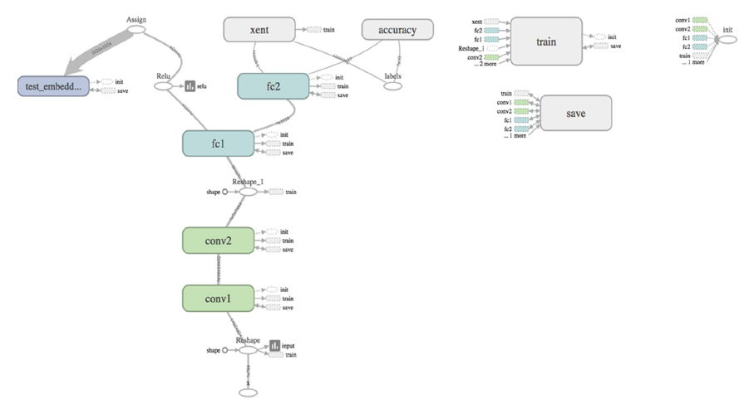
Figure 1

Slide 14
Numerical Examples
In the first step, a 1 x 2,034 binary vector is constructed to represent the activity chain on the assigned travel date for each participant.
Then the Jaccard similarity coefficient is calculated for every pair of individuals according to their activity matrices.
The Jaccard similarity coefficient becomes the link weight between a pair of individuals. The Jaccard similarity coefficient ranges from 0 to 1.
In this paper, an edge is built between two individuals in the community structure when the matrix similarity is greater than 0.9 .
An undirected graph is constructed with 3,887 nodes and 98,026 edges, shown in Figure 5. An experiment is conducted to find an appropriate threshold u of matrix similarity on 0.85, 0.9, and 0.95.
When u is 0.85, there are too many edges and the ratio of edge to node is too high. When u is set as 0.95, the number of the node is too low and the ratio of edge to node is too low as well.
Gephi algorithm is applied with, a graph visualization tool.
The nodes isolated with others or not clustered in any groups are also displayed in the periphery in gray color, and they are considered as Cluster 7.
From Table 3, Cluster 1 and Cluster 2 represent individuals who do not go to work. Cluster 3, Cluster 4 and Cluster 5 need to work a lot. From Table 3, individuals in Cluster 1 conduct more shopping activities, whereas individuals in Cluster 2 do many more recreation activities. Figure 3a shows the starting time of the first working activity. To separate Cluster 3 and 4, refer to Figure 3b that presents the working duration distribution. Cluster 3 shows a high probability of working approximately 9 hours per day. However, for Cluster 4, the working duration, which is around 5 hours, is much shorter than Cluster 3.The working duration distribution for Cluster 5 is also flat and ranges from 4 to 12 hours.
There are 7 classes in classification task, in addition to the 6 classes which are identified by community detection algorithm.

Slide 15
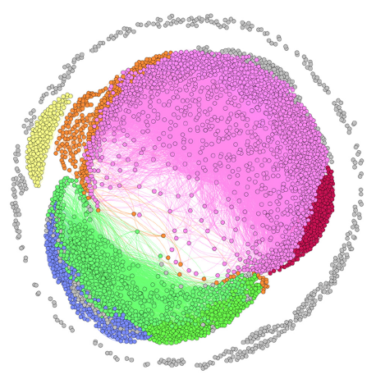
Figure 2

Slide 16
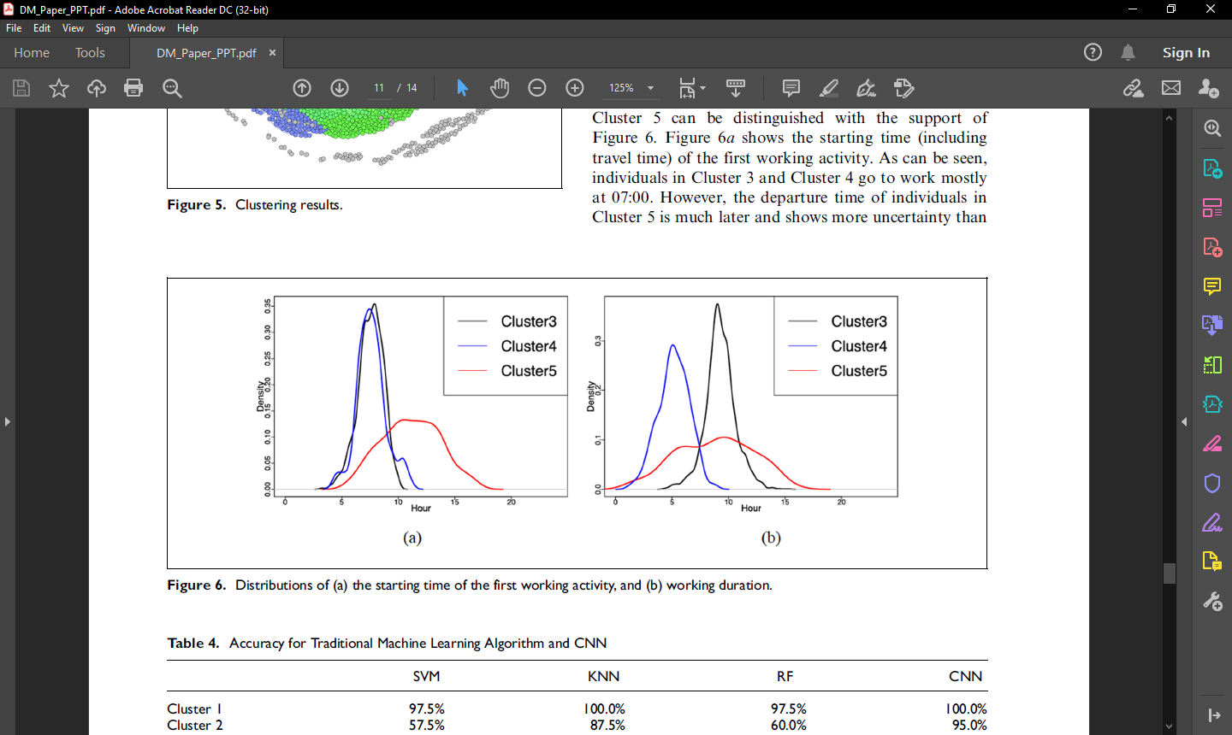
Figure 3

Slide 17
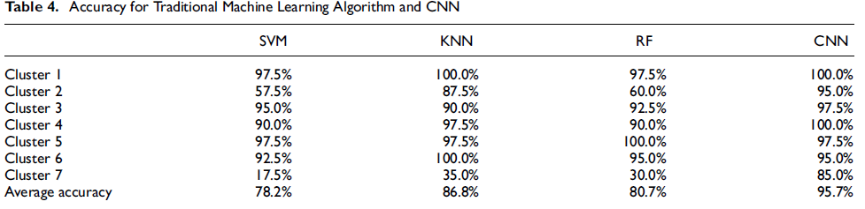
Table 4

Slide 18
Conclusion
In this paper, CHTS data is used to analyze and classify travel behavior.
After processing raw data, some interesting observations are made.
First, travelers make more commute trips to work and school during weekdays but more recreation, shopping, and personal business activities on weekends.
Third, most individuals have a low degree of spatial variability.
Based on 5-minute interval and eight activity types, an activity matrix is further constructed for each participant.
Jaccard similarity coefficient is employed to calculate the similarity between every pair of participants.
After this, a community detection algorithm is adopted to cluster individuals into groups with the same travel behavior.
The algorithm produces seven clusters:
1) non-working people with more shopping activities.
2) non-working people with more recreational activities.
3) individuals with normal working start time and a full-time job.
4) Individuals with part-time job.
5) individuals with late start working time.
6) individuals who need to attend school.
7) individuals that are not in any of the first 6 clusters.
Then individuals are classified by using a CNN and approximately 95% is achieved in accuracy.
In future, a variety of data sources, including passive trip trajectory data, transit smart card data, and social media data can be collected to provide more information about individual travel behavior.

Slide 19

Thank You

